Slide 1


Module 5
Development of Surfaces
Sheba Varghese
Assistant Professor,
Dept. Of Mechanical Engineering,
Room : A (310), KJSCE, Vidyavihar
Email : sheba@somaiya.edu

Slide 2
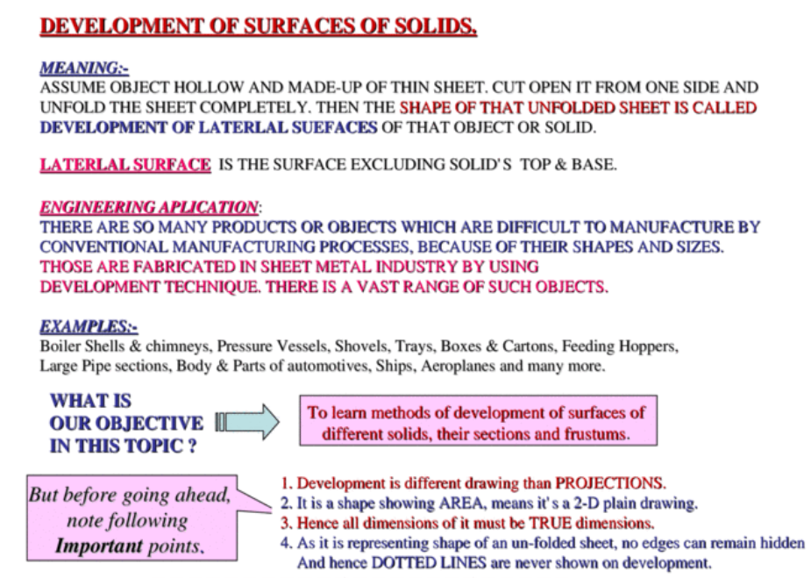
Introduction

Slide 3
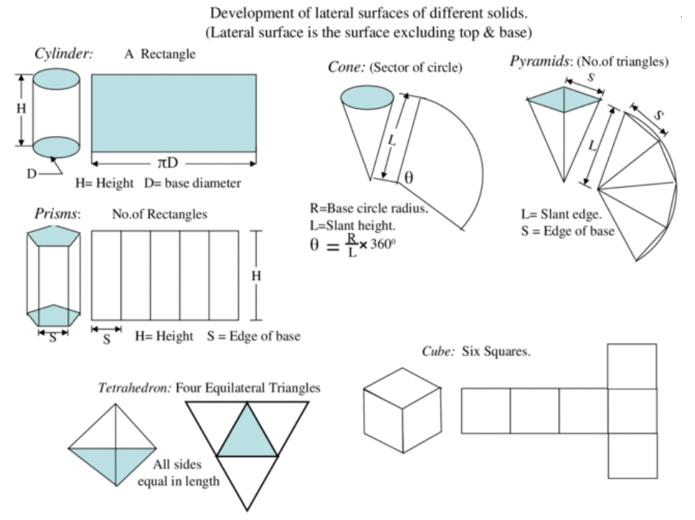

Slide 4
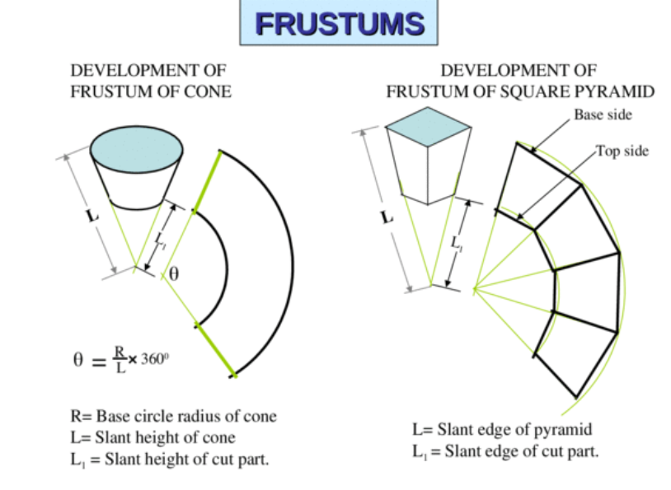

Slide 5
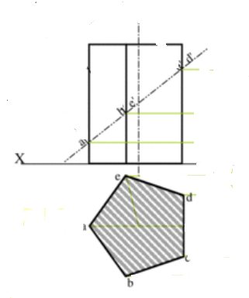
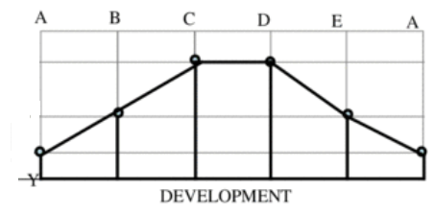
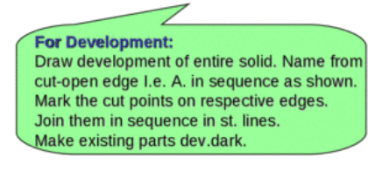
Q. A Pentagonal prism, 30 mm side of base and 50 mm axis is standing on HP on its base with one of the side of base perpendicular to VP. It is cut by a sectional plane inclined at 40 to the HP, through midpoint of axis. Draw the F.V, T.V and development of the surface of the remaining solid.

Slide 6
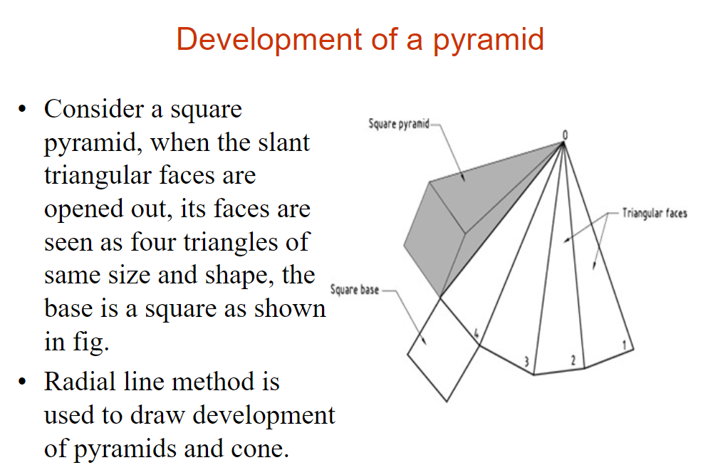

Slide 7
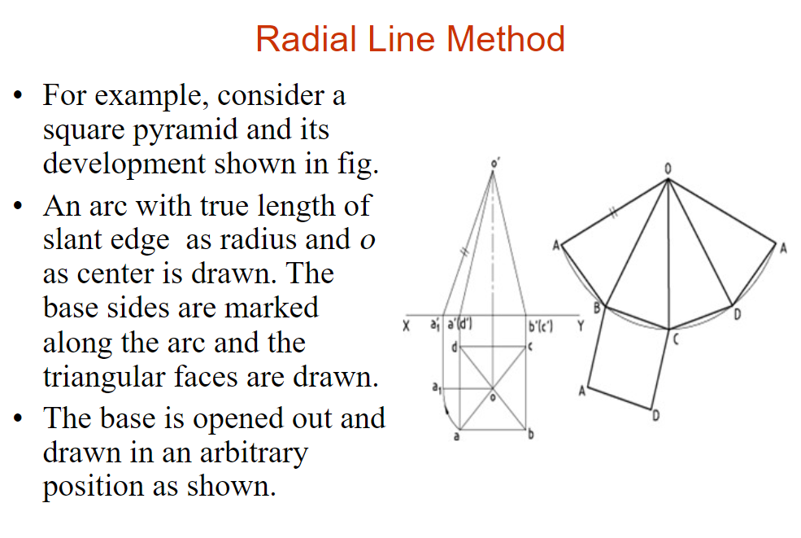

Slide 8
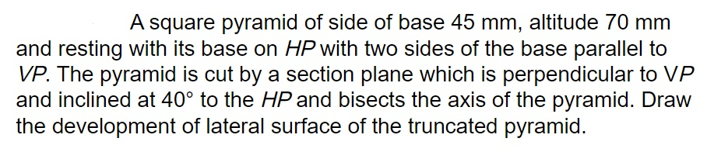
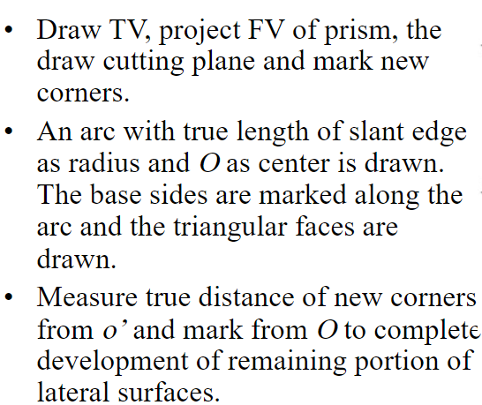

Slide 9
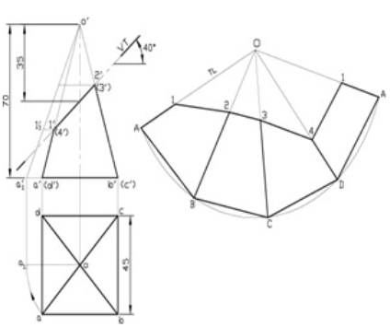

Slide 10
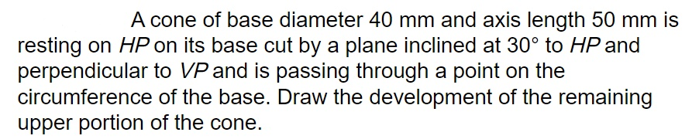
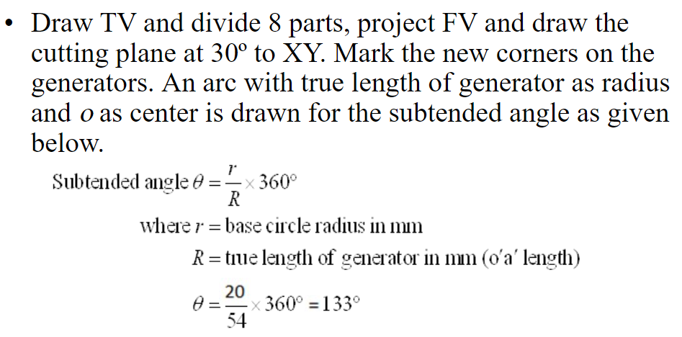

Slide 11
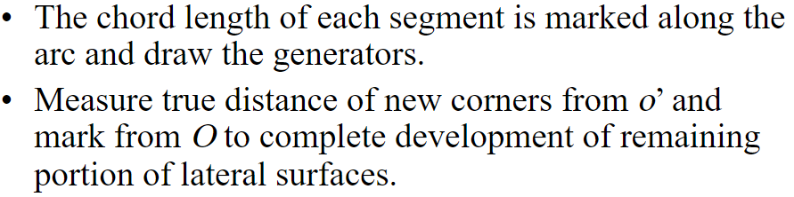

Slide 12
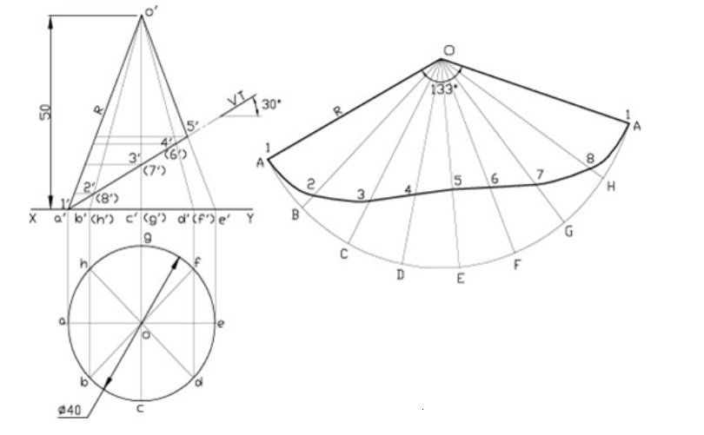

Slide 13
Questions having section and development together

Slide 14
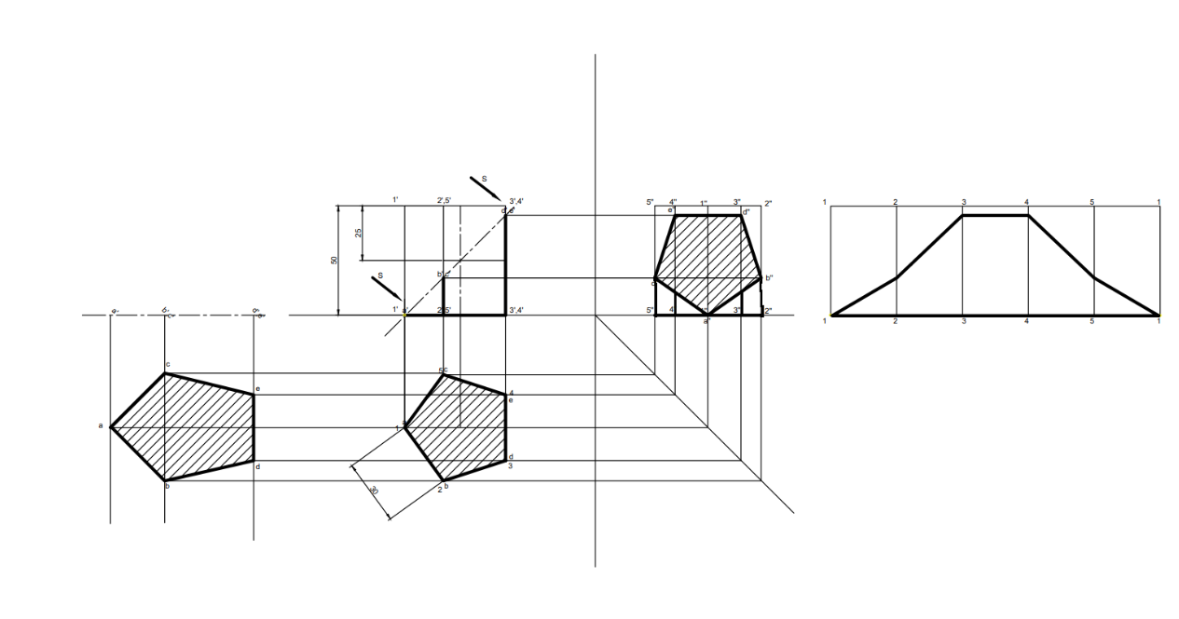
Q. A Pentagonal prism, 30 mm side of base and 50 mm axis is standing on HP on its base whose one side is perpendicular to VP. It is cut by a section plane 45 ̊inclined to HP., through the midpoint of axis. Draw F.V, Sectional T.V and Sectional S.V. Also draw trues shape of section and development of surface of remaining solid.

Slide 15
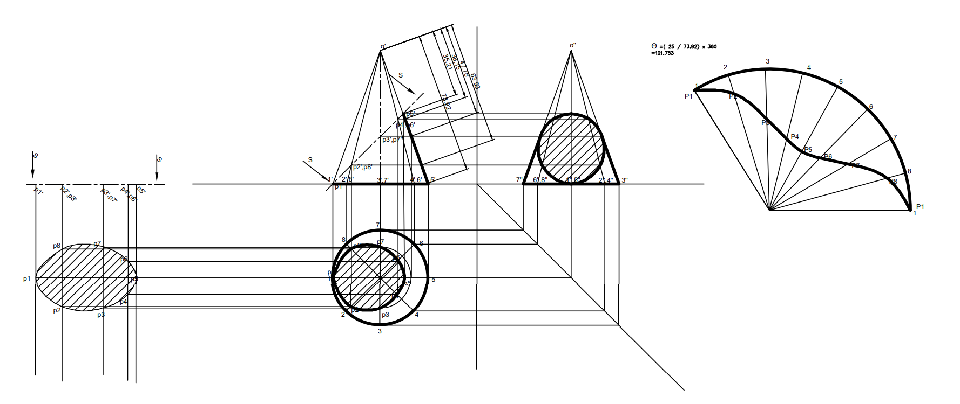
Q. A cone , 50 mm base diameter and 70 mm axis is standing on its base on H.P. It is cut by a section plane 45 ̊inclined to H.P through base end generator. Draw projections , sectional views, true shape of section and development of surfaces of remaining solid.

